Slide 1
Angle Modulation (part two)
EE20422
yanyan.wu@xjtlu.edu.cn
Department of Electronics and Electrical Engineering
Xi’an Jiaotong – Liverpool University

Slide 2
Lecture Seven
Broadband FM
Bandwidth of FM waves
Carson’s rule
Universal curve
Generation of FM waves
Demodulation of FM signals

Slide 3
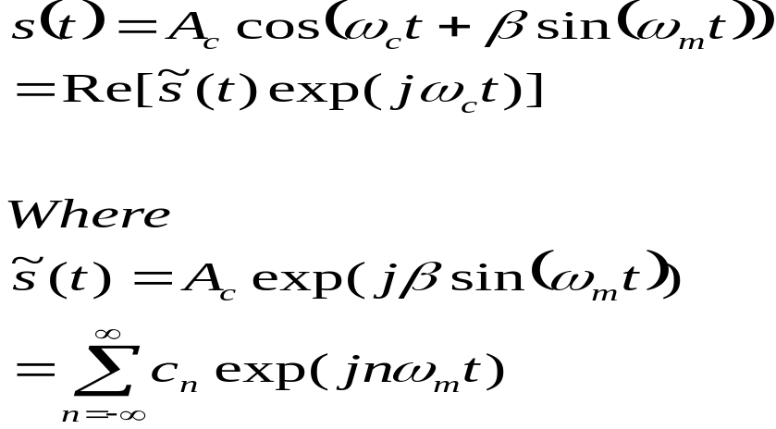
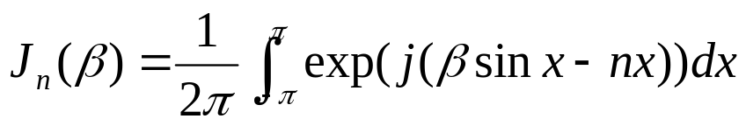

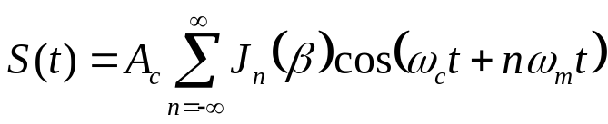
FM Signal : expressed by Fourier Series
Fourier coefficients are obtained as Bessel function

Slide 4
Bessel Functions of the First Kind
X = 0:0.1:20;
J = zeros(5,201);
for i = 0:4
J(i+1,:) = besselj(i,X);
end
plot(X,J,'LineWidth',1.5)
axis([0 20 -.5 1])
grid on
legend('J_0','J_1','J_2','J_3','J_4','Location','Best')
title('Bessel Functions of the First Kind for n = 0,1,2,3,4')
xlabel('\beta')
ylabel('J_n(\beta)')

Slide 5
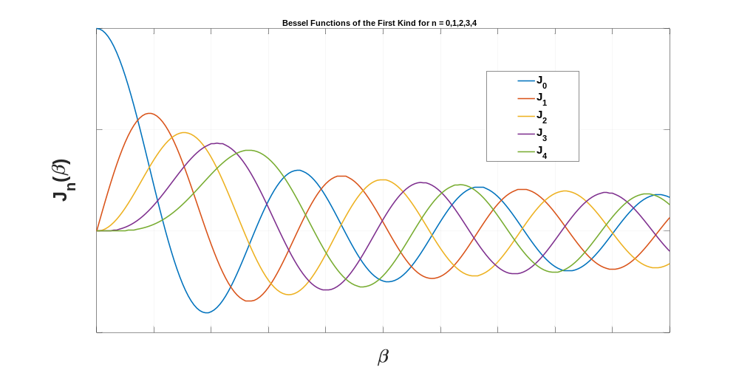
Bessel Functions of the First Kind

Slide 6
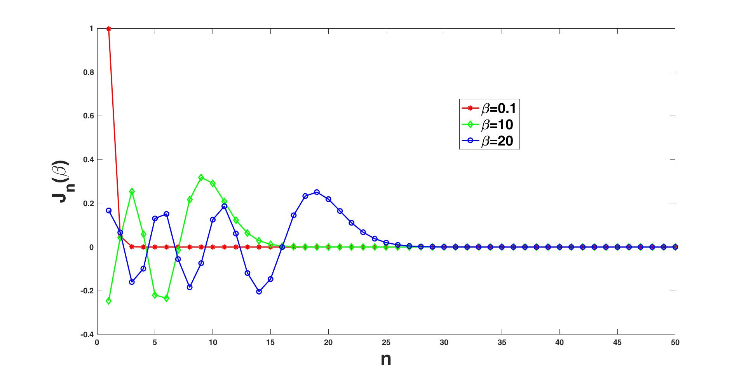
Bessel Functions of the First Kind

Slide 7
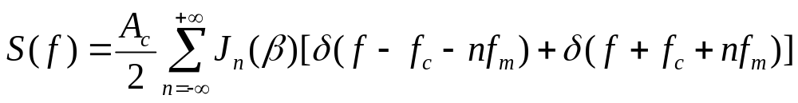
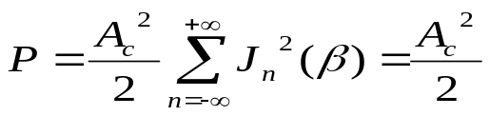
FM spectrum properties
The spectrum of the FM signal s(t) contains a carrier component and an infinite set of side frequencies located symmetrically about the carrier frequency.
When β<<1, J₀ (β)≈1, J₁(β) ≈ β/2, J_{n}(β) ≈ 0 (n>2), hence FM is effectively composed of carrier and a single pair of side –frequencies.
The average power of FM is

Slide 8
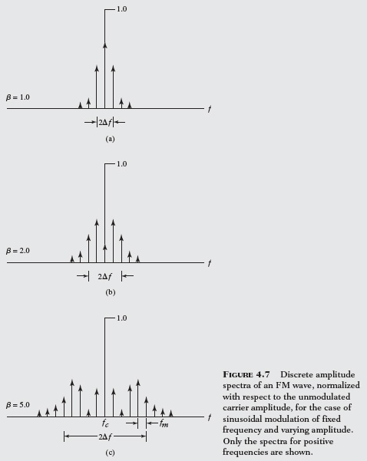
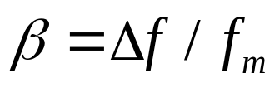
Illustration of FM Signal Spectra
Consider f_{m} fixed, the variation of β results in two extremes of bandwidth representation .
When β>>1, B=2Δf
When β<<1, B=2f_{m}

Slide 9
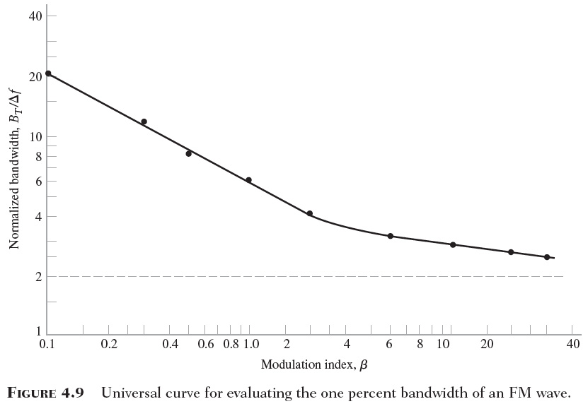
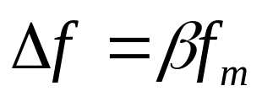
B _{T}=2n_{max}f_{m}, where n_{max} is the largest value that satisfies lJ_{n}(β) l>0.01

Slide 10


Carson’s rule for bandwidth of FM signal
Carson defined a simple effective bandwidth as a function of modulation index β and bandwidth f_{m} of base band message based on the simple empirical relation:
When β>>1, the side frequencies that are separated from the carrier frequency by the amount grater than the frequency deviation are decreased rapidly toward zero.
When β<<1, the bandwidth needed for narrowband FM is 2f_{m} , the same as for AM.
How about β in between two extremes ?
Carson’s rule gives a slight underestimate of the actual bandwidth needed for an FM signal

Slide 11
Example
In North America broadcast FM radio employs a maximum frequency deviation of 75KHz, Broadcast FM use a carrier frequency between 88MHz to 108MHz, and provides a baseband bandwidth (fm) of 15KHz.
How much is the modulation index β?
Consider the required bandwidth?

Slide 12
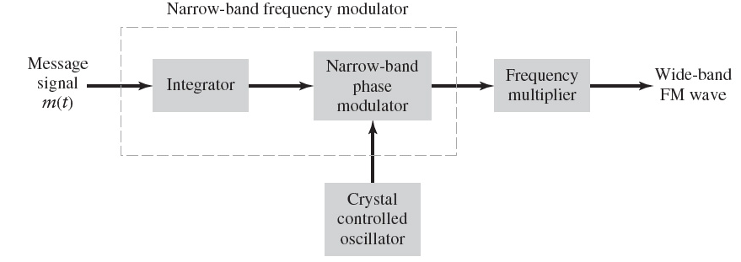
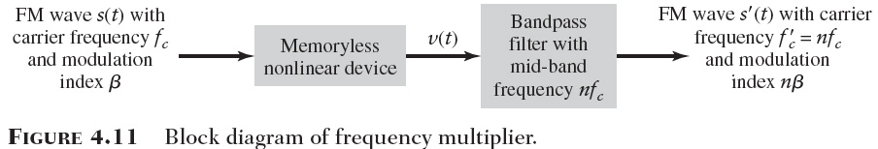
Generation of FM Waves

Slide 13

How this works
Problem 4.24
Tips: Identify the mistakes in the above answer sheet.

Slide 14
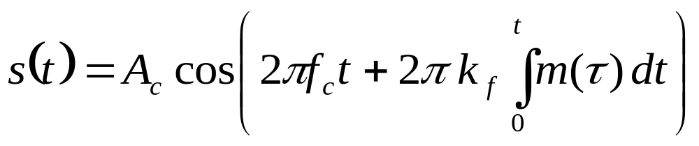
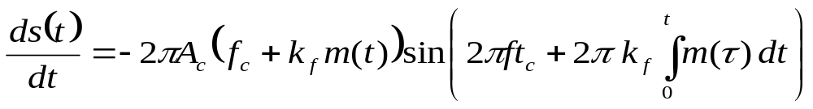
FM Demodulation

Slide 15
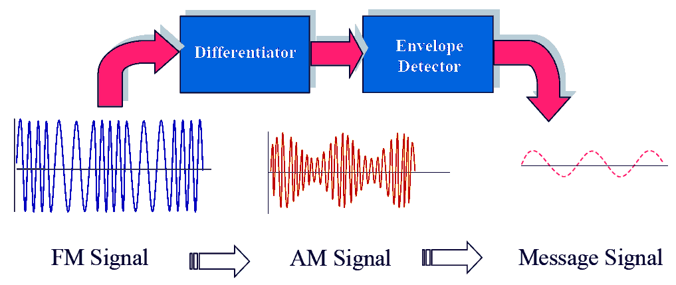
FM Demodulation: Discriminator

Slide 16
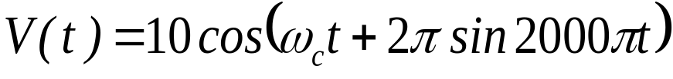
Class Activity
The output signal of an angle modulator is given as
If this is a frequency modulated (FM) signal,
a) Determine the original message signal.
b) Find the instantaneous frequency as a function of time and then sketch it.
c) Obtain the modulation index.
d) If this is a PM signal, determine the message signal.

Slide 17
Question One
The FM broadcasting system adopted in the UK employs a frequency deviation of +75kHz .
The message bandwidth is 15 kHz for monophonic transmission and 53 kHz for stereo.
Determine the approximate bandpass channel bandwidth required in each case;
Compare this with the bandwidth requirements for DSB-SC.

Slide 18
Question Two
[Stremler, Example 6.3.2, p. 314]
A 10 MHz carrier is frequency modulated by a sinusoidal signal such that the peak frequency deviation is 50kHz. Determine the approximate bandwidth of the FM signal if the modulating sinusoid is (a) 500 kHz, (b) 500 Hz, (c) 10 kHz
Answers:
1 MHz
100 kHz
160 kHz

Slide 19
Question four
[Stremler, Example 6.3.2, p. 314]
An FM signal is given as 10 cos [10⁶πt + 8sin 1000πt]
Determine (a) the carrier frequency (ans: 500 kHz)
(b) instantaneous frequency .
(c) the modulation index (ans: 8)
(d) the maximum frequency deviation (ans: 4 kHz)

